Slide 1
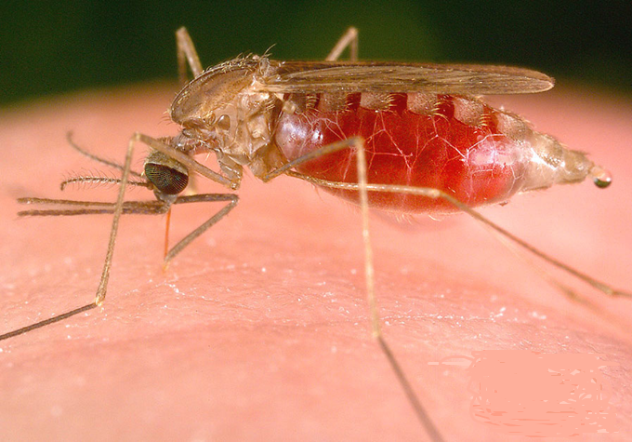
Capstone Project 2 Detection of Malaria Using Image Processing
About Malaria
Malaria is spread by the bite of the female Anopheles mosquito.
This species of mosquito is located world wide including in the United States.
The mosquito becomes infected with the Plasmodium parasite by feeding on the blood of an infected human.
The mosquito ingests the gametocytes (Sexually reproducing cells) of the parasite, which will take between 10-18 days to grow inside the mosquito.

Slide 2
Goal And Target Audience
Q. What is the problem you want to solve?
Goal of Project is detection of malaria cell-images using Deep Neural Network.
Q. Who is your client and why do they care about this problem?
It can be used by Medical Staff as Lab Technician or Help Doctors. And world care about this because……

Slide 3
Infection Rates
1,700 cases diagnosed in the United States each year
Primarily in return travelers and immigrant populations (“import” malaria)
212 million cases globally
429,000 deaths in 2015
In Africa, malaria costs around $12 billion a year in treatment, prevention, and premature death.

Slide 4
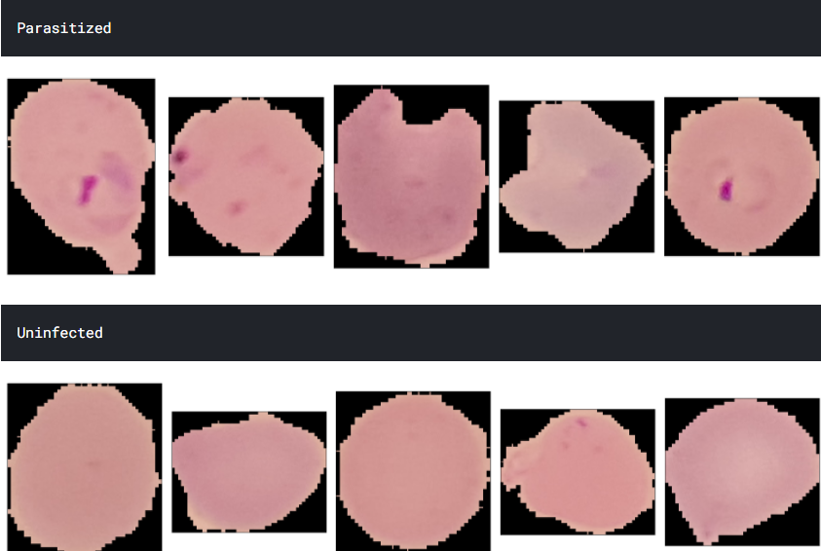
Blood Sample Images
Blood sample images of patients found malaria positive [ Parasitized ] and those are Uninfected

Slide 5
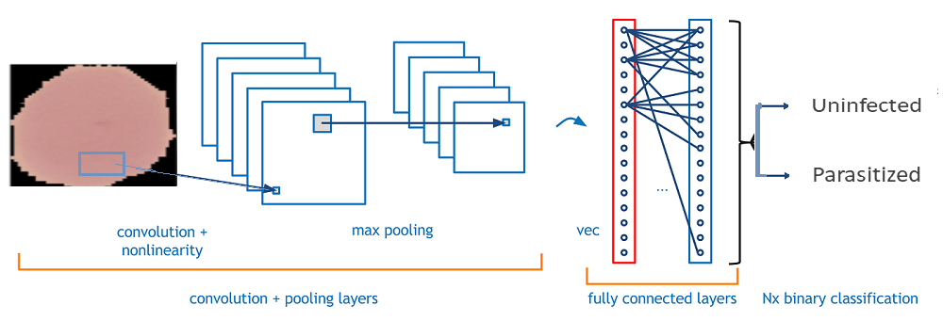
How Deep Learning and CNN works
Different Layers in Convolutional
Neural Network.
Input layer
Convo layer (Convo + ReLU)
Pooling layer
Fully connected(FC) layer
Softmax/logistic layer
Output layer

Slide 6
Approach and Solution
1. Data Exploration and Analysis
2. Preprocessing of the data.
3. Defining the Model.
4. Build the Model
5. Train the Model
6. Fit the model
7. Predict the test data and Calculate the Score , Accuracy
Step taken to solve the problems →

Slide 7
Data Exploration and Analysis
Data quality and common problems
Common data problems when training Object Detection models include:
Image dimensions and aspect ratios
Labels composition – imbalances, bounding box sizes, aspect ratios
Data preparation not suitable for your dataset.
This step includes exploring the images dataset and checks by raising questions like ,
Q. Is the dataset balanced for the each class?
Dataset contains two classes -
Number of Parasitized Images are = 13780
Number of Uninfected Images are = 13780
Q. Do we need more data to predict the problem?
Q. What is the size of the image in each class?
Hight
Width
Channels

Slide 8
Preprocessing of the data
To Feed the data to CNN network , Preprocessing is necessary.
[ Scaling , Normalization ]
Images are normally 2 dimensional with 1 or 3 color channels.
Preprocessing of images involve conversion of images into gray scale image. It will help to speed up the training process at least 3 times faster than 3 channel image.
[2 dimensional image with 1 channel is called Gray Scale]
Preprocessing also contain splitting the data into train and test set.

Slide 9
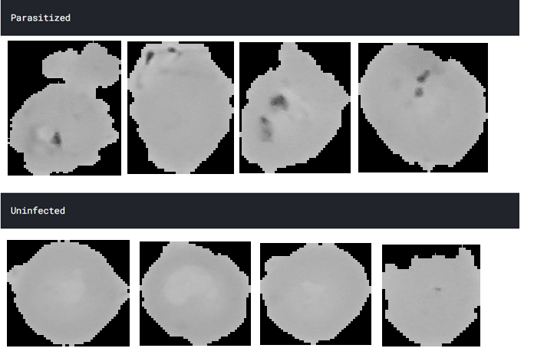
Preprocessed Gray Scale Images
Sample after converted to Gray Scale Images

Slide 10
Preprocessing – Reduce Size of Images
Why do we resize images during the pre-processing phase?
Some images captured by a camera [ or any source ] and fed to AI algorithm vary in size, therefore, we should establish a base size for all images fed into AI algorithms.
Actual Image Size from the dataset-
IMAGE 1: (139, 160, 3),
IMAGE 2: (208, 148, 3)
After pre-processing Gray scale images size -
IMAGE DATA : (50, 50, 1)

Slide 11
Build Train and Fit Model
Build the Model -
Define the model that will take input as pre-processed data [ input layers ]
Need Of Convolutional Layer
Add Convu Layers Pooling Layers & Fully connected Layers into the model.
Solve classification problem by adding Softmax Layers and generate output .
Use Train data to train and Fit model.

Slide 12
CNN Neural Network Architecture
In deep learning, a convolutional neural network (CNN) is a class of deep neural networks, most commonly applied to analyzing visual imagery.
In a CNN, the input is a tensor with shape (number of images) x (image height) x (image width) x (input channels).
After passing through a convolutional layer, the image becomes abstracted to a feature map, with shape (number of images) x (feature map height) x (feature map width) x (feature map channels).
e.g. inputShape = (19290 x 50 x 50 x 1)
model.add(Conv2D(32, (3,3), activation = 'relu', input_shape = inputShape))

Slide 13
CNN Neural Network Architecture
Repeating the above Process with different Filters , i.e.
the dimensionality of the output space (i.e. the number of output filters in the convolution). 16 and 8
example in Keras - model.add(Conv2D(16, (3,3), activation = 'relu’))
example in Keras - model.add(Conv2D(8, (3,3), activation = 'relu’))
After Every convolutional neural network (CNN ) , Add MaxPooling2D Layer [ to reduce the dimension ]
example in Keras - model.add(MaxPooling2D(2,2))

Slide 14
CNN Neural Network Architecture
Batch normalization is a technique for training very deep neural networks that standardizes the inputs to a layer for each mini-batch. This has the effect of stabilizing the learning process and dramatically reducing the number of training epochs required to train deep networks.
Use Batch normalization after every Convolutional neural network and MaxPooling Layer, before passing input to next Iteration .
example in Keras - model.add(BatchNormalization(axis = chanDim))
Flatten & Dense
Flatten is the function that converts the pooled feature map to a single column that is passed to the fully connected layer. Dense adds the fully connected layer to the neural network.
example in Keras - model.add(Flatten())
example in Keras - model.add(Dense(512, activation = 'relu'))

Slide 15
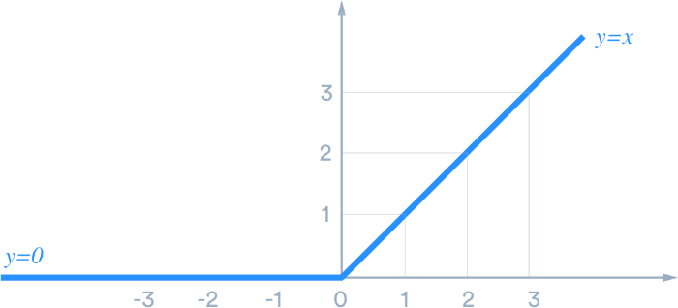
CNN Neural Network Architecture
Activation Function - ReLU
A neural network without activation function will act as a linear regression with limited learning power.
But we also want our neural network to learn non-linear states as we give it complex real-world information like images

Slide 16
CNN Neural Network Architecture
def ReLU(x):
if x>0:
return x
else:
return 0

Slide 17
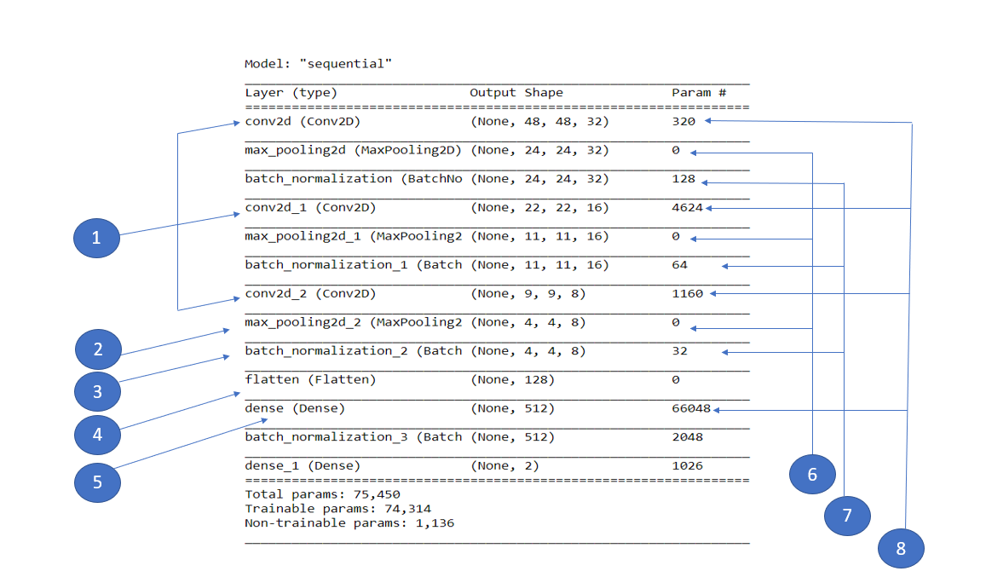
Model Summary

Slide 18
Neural Network Architecture
1. Convolutional Layer
2. Max Pooling Layer
3.Batch Normalization
4.Flatten
5.Dense Layer
6. Max Polling does not have parameter to learn,
7.Number of Parameters Learned in Convolutional Layer
8.Number of Parameter learned in Batch Normalization
param_number = output_channel_number * (input_channel_number * kernel_height * kernel_width + 1)

Slide 19
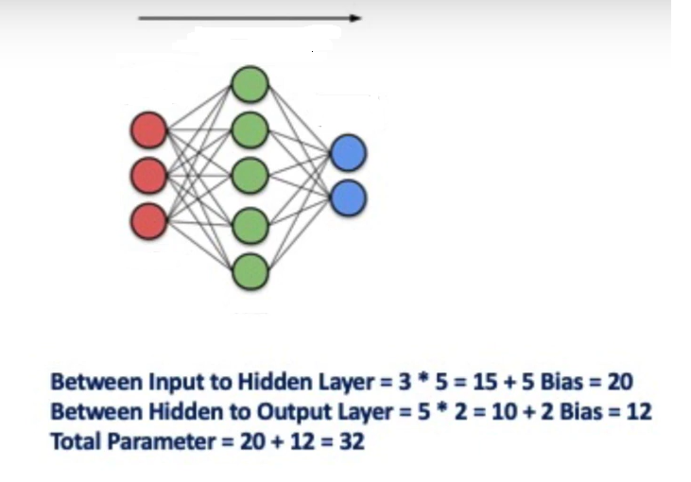
Neural Network | Count number of Learnable Parameter in Deep Learning
Hidden Layer
Input Layer
Output Layer
2 Units
3 Units
5 Units

Slide 20
Results understanding
Prediction & Model Accuracy
Finally Predict the model on test data
Create Confusion Matrix , Classification Report .
Inspecting model results and performing error analysis can be a tricky process. Having one metric, rarely tells you the whole story and if you do have one interpreting it can be a relatively hard task.

Slide 21
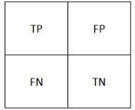
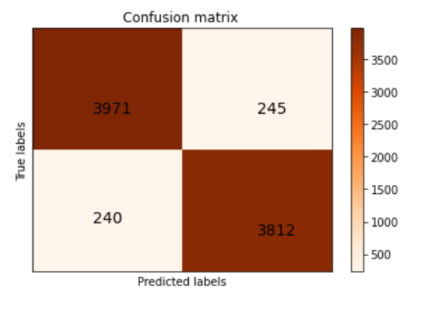
True Positive:
Interpretation: You predicted positive and it’s true.
You predicted that Parasitized Images – 3971 and it’s true
True Negative:
Interpretation: You predicted negative and it’s true.
You predicted that Uninfected Images – 3812 and it’s true
False Positive: (Type 1 Error)
Interpretation: You predicted positive and it’s false.
You predicted that Parasitized Images – 245 But they are Uninfected
False Negative: (Type 2 Error)
Interpretation: You predicted negative and it’s false.
You predicted that Uninfected Images – 240 But they are Parasitized

Slide 22
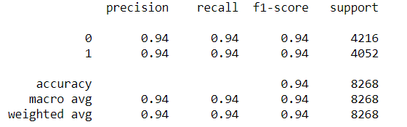
Classification Report .
Accuracy of the model is 0.94 %
F1-Score 0.94
Precision 0.94

Slide 23
Code Implementation
Below Contains the GitHub Links for Jupyter Notebooks and Python Code.
1. https://github.com/SANDIP79190219/Deep Learning/blob/main/Maleria_Deep_Learning_Grayscale.ipynb
2. https://github.com/SANDIP79190219/Deep-Learning/blob/main/Deep_Learning_Maleria.ipynb
Dataset Source - Malaria Cell Images Dataset | Kaggle

